Slide 1


BUSINESS
INTELLIGENCE
TOOLS
CSC 46000

Slide 2



TEAM 4
Haoliang Zhang
Nadia Ben Slima
Kevin Song

Slide 3



TABLE OF CONTENTS
Introduction to Business Intelligence Tools
Overview of Popular BI Tools
Comparison of BI Tools
Use Cases and Target Users
Conclusion

Slide 4


BUSINESS
INTELLIGENCE
TOOLS

Slide 5
TABLEAU
Drag-and-drop interface
Interactive dashboards & charts
Connects to multiple data sources
Real-time insights
PROS
CONS
Easy to use
Great visualizations
Wide data integration
Expensive licensing
Steep learning curve (advanced features)
Limited data prep

Slide 6

POWER BI
Data visualization & interactive dashboards
Real-time dashboards
Seamless integration with Microsoft products
Supports hundreds of data sources
PROS
CONS
User-friendly
Cost-effective & scalable
Strong Microsoft ecosystem integration
Limited custom visuals
Performance issues with large datasets
Pro licenses required for collaboration

Slide 7
SEABORN
Open-source library for statistical graphics
Creates high-quality, static charts and plots
Integrates with Pandas and NumPy for data manipulation
Ideal for statistical analysis and trend visualization
PROS
CONS
Presentation-ready visuals
Built-in support for complex statistical plots
Free and open-source
Static visualizations
Requires Python programming knowledge
No built-in dashboard/self-service analytics
Performance issues with large datasets

Slide 8

COMPARISON TABLE

Slide 9

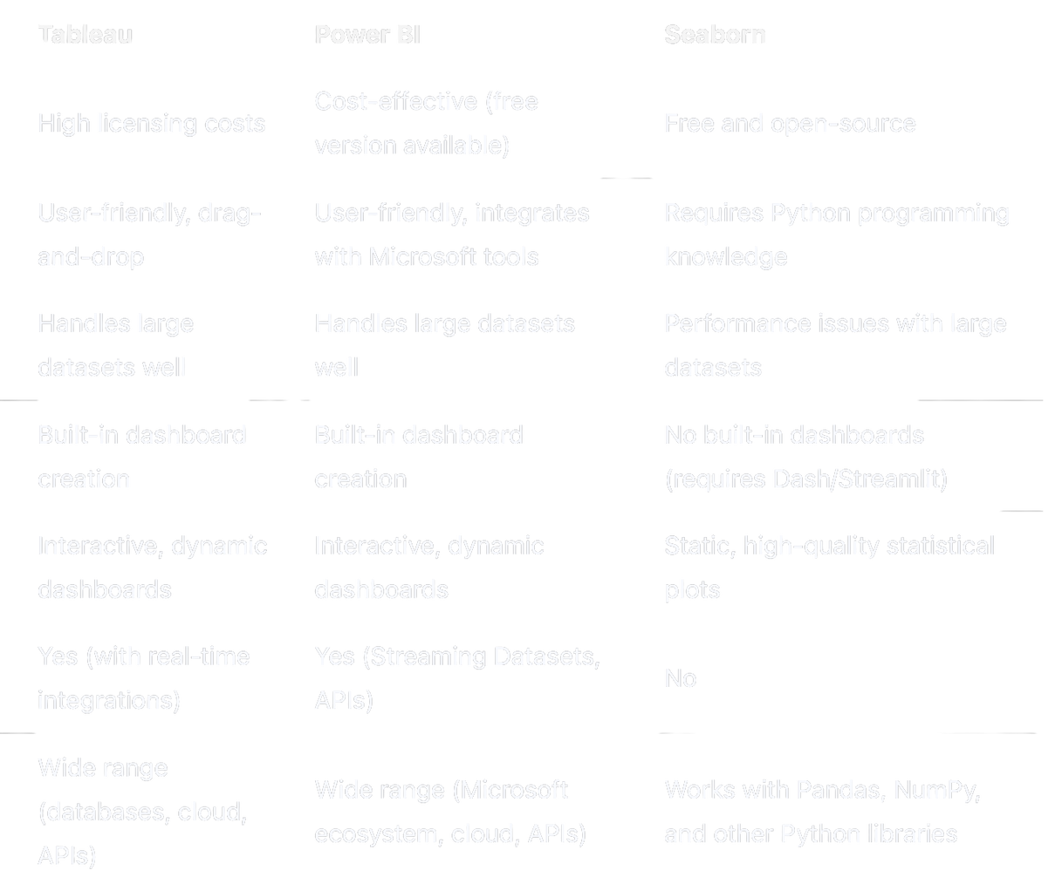
Feature
Cost
Ease of use
Scalability
Dashboards
Visualizations
Real-Time Updates
Data sources
Comparison Table: Tableau vs. Power BI vs. Seaborn

Slide 10

USE CASES
AND TARGET USERS

Slide 11
USE CASES AND TARGET USERS
Power BI
Enterprises, Microsoft ecosystem, finance, healthcare, retail (real-time dashboards).
Business analytics courses, limited research use.
Tableau
Consulting, marketing, tech (interactive dashboards, data storytelling).
Data visualization courses, research visualizations.
Seaborn
Tech startups, research-driven companies (static, high-quality visualizations).
Data science, statistics, machine learning courses, research.

Slide 12
THANK
YOU

